Slide 1
SECURE DATA HIDING IN IMAGES USING STEGaNOGRAPHY
CAPSTONE PROJECT
Presented By:Prathamesh Sanjiv Lahase
Student Name : Prathamesh Sanjiv Lahase
College Name & Department : Thakur Polytechnic & Computer Engineering

Slide 2
OUTLINE
Problem Statement
Technology used
Wow factor
End users
Result
Conclusion
Git-hub Link
Future scope

Slide 3
Problem Statement
- Data security and privacy are major concerns in today's digital world.
- Sensitive information needs to be protected from unauthorized access.
- Current methods of secure data transmission have limitations.

Slide 4
Technology used
- Programming Language: Python
- Library: OpenCV
- Framework: Jupyter Notebook

Slide 5
Wow factors
- Hide sensitive information within images using Steganography.
- Secure data transmission without arousing suspicion.

Slide 6
End users
PRATHAMESH SANJIV LAHASE

Slide 7
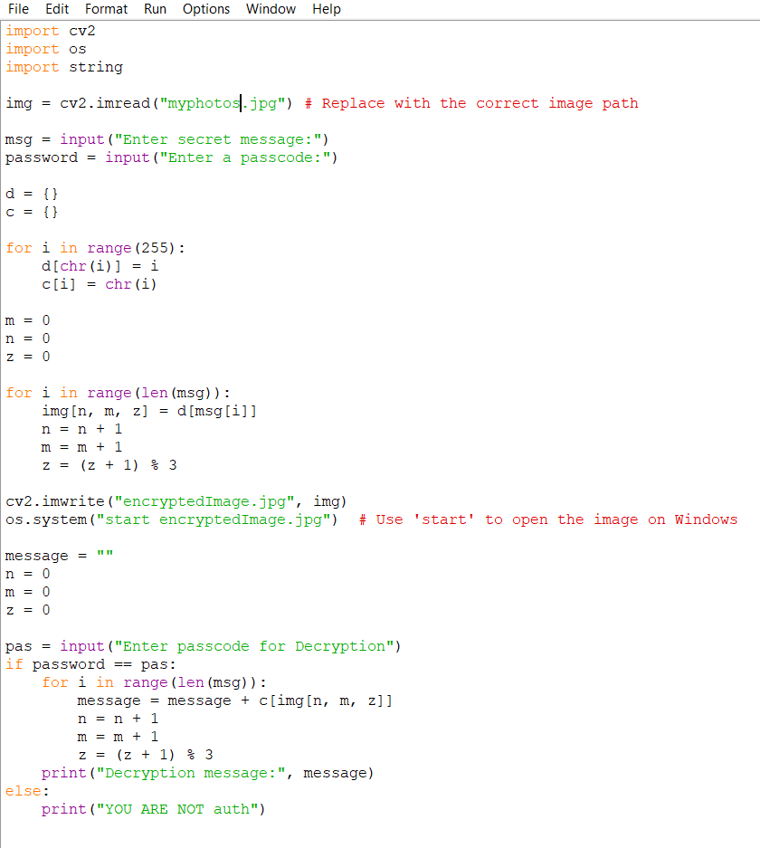
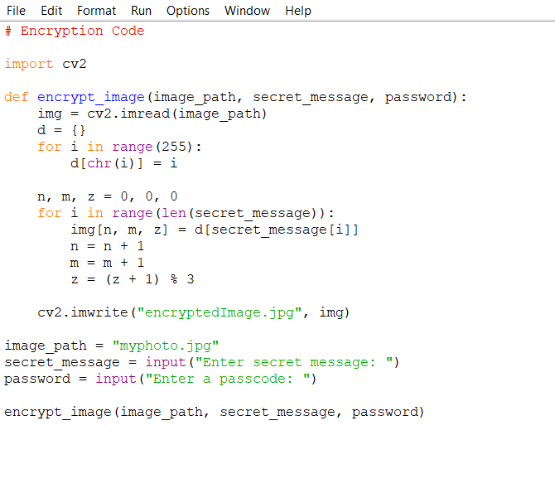
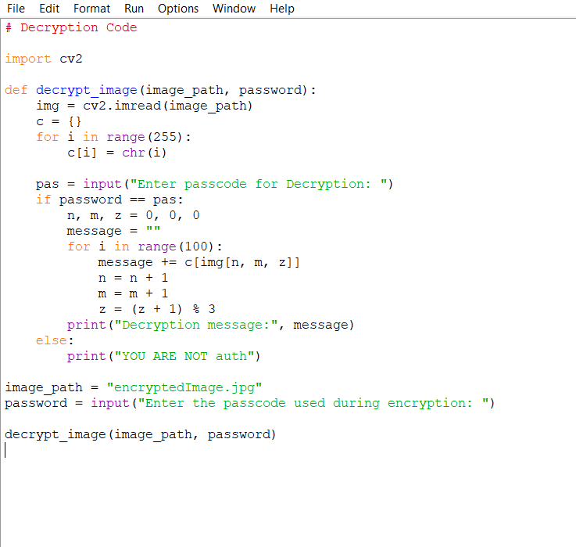


Results

Slide 8
Conclusion
- Steganography provides a secure method for data transmission.
- Python and OpenCV offer a suitable platform for implementation.

Slide 9
GitHub Link
https://github.com/Prathamesh-Lahase/myproject_aicte.git

Slide 10
Future scope(optional)
- Improve Steganography algorithm for increased security.
- Explore applications in audio and video files.

Slide 11
THANK YOU

